Slide 1
Controlling laptop working with hand gestures(like a mouse)
Submitted in the partial fulfillment for the award of the degree of
BACHELOR OF ENGINEERING
IN
Big Data Analytics
Submitted by:
Kaustubh Naithani 20BCS4000
Prashant Kumar 20BCS4363
Dhruva Malik 20BCS3976
Mohammed Bilal 20BCS3994
Under the Supervision of:
Dr Monika Singh
Department of AIT-CSE
DISCOVER . LEARN . EMPOWER

Slide 2
Outline
Introduction
Scope of the Project
Planning to implement

Slide 3
Introduction
Computers have seamlessly integrated into our daily routines, simplifying human-computer interaction (HCI). However, individuals with disabilities face distinct challenges in utilizing these devices effectively. This project introduces a gesture-based AI virtual mouse system, leveraging computer vision to execute mouse tasks using hand movements and fingertip detection. The system's core objective is to replace the conventional mouse with a web or built-in camera, enabling cursor control and scrolling through hand gestures.

Slide 4
Feature/characteristics Identification
Hand Gesture Recognition
Real Time Processing
Different gestures to perform different tasks
Move cursor using index finger
Left click using middle finger
Scrolling using open hand
Closing the program my making a fist
Camera with atleast 720p camera feed.
Scalability

Slide 5
Constraint Identification
The Implementation is subject to the following constraints
A personal computer with python installed
Camera Quality
Lightning Conditions
Distance from the camera
Complexity of the Gesture
Speed of performing gestures
System Resources

Slide 6
Analysis of Features and finalization subject to constraints
Balancing Features and Constraints
Choosing Priority Features
User Experience Impact
Iterative Process
Performance Trade-offs
Testing and Validation
Relevance to End-Users

Slide 7
Design selection
Choosing Technologies
Designing system architecture subject to constraints
Gesture Design
User Interface
Hardware Selection
Usability
Flexibility and Customization
Error Handling

Slide 8
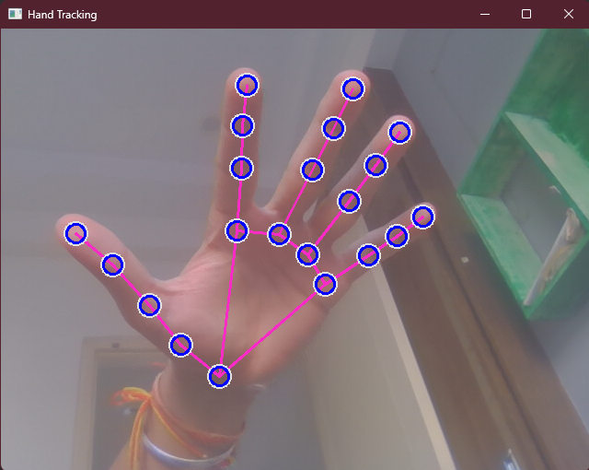
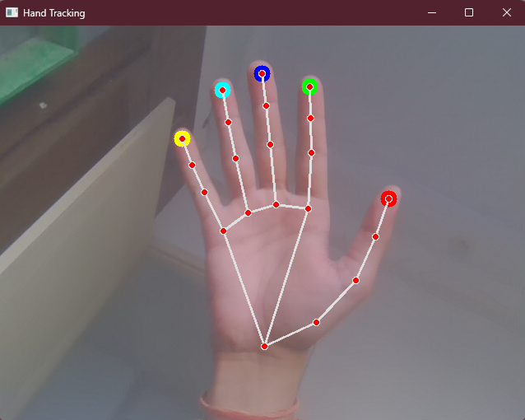
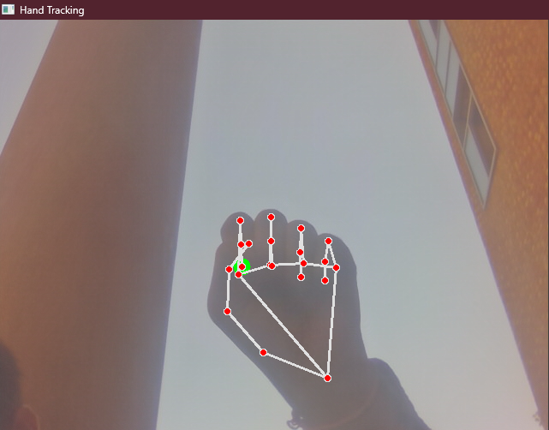
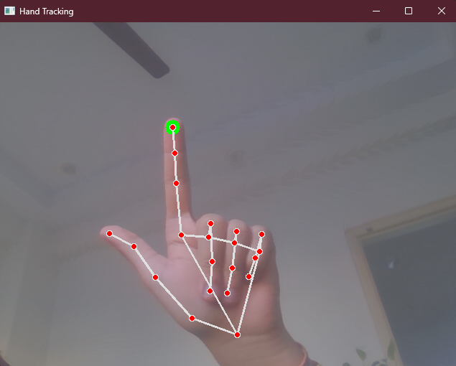
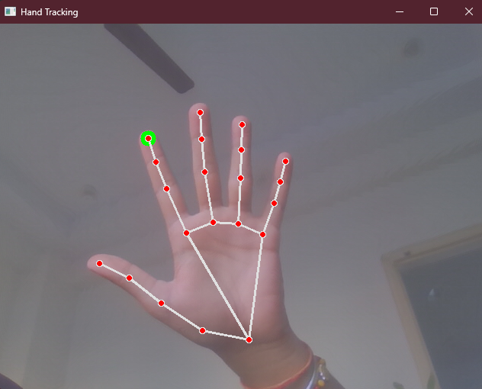

Slide 9
Thank you

